Slide 1


HealthQuote AI - Medical Insurance Price Prediction using ML
This project focuses on developing a machine learning model that predicts medical insurance prices based on various features such as age, gender, BMI, number of children, smoking status, and geographical region. The primary objective is to provide an accurate estimation of insurance costs, helping individuals and organizations make informed decisions about healthcare coverage.
by Mohammed Abdul Rehman

Slide 2

PROJECT OVERVIEW
Data Understanding: Gain insights into the medical insurance dataset, identifying key features that influence insurance costs.
Data Preprocessing: Clean and prepare the data for modeling, including handling missing values, encoding categorical variables, and scaling features if necessary.
Model Development: Build and evaluate different machine learning models to predict insurance costs, selecting the best-performing model.
Model Deployment: Deploy the model using Fast API, making it accessible for real-time predictions through a REST API.
Insights and Interpretation: Analyze the model’s predictions to understand the impact of various factors on insurance pricing.
This Photo by Unknown Author is licensed under CC BY

Slide 3
PYTHON LIBRARIES USED
NumPy: A library for numerical computing, offering efficient operations on large arrays and matrices.
Pandas: A data manipulation library providing tools for cleaning, analyzing, and managing structured data using DataFrames and Series.
Seaborn: A visualization library built on Matplotlib, designed for creating statistical graphics and easy plotting of complex data.
scikit-learn: A machine learning library that offers tools for data preprocessing, modeling, and evaluation with various algorithms.
FastAPI: A high-performance web framework for building APIs, featuring automatic data validation, asynchronous support, and interactive documentation.

Slide 4
DATASET OVERVIEW
The dataset typically contains the following features:
Age: The age of the individual.
Sex: Gender of the individual (encoded as male or female).
Bmi: Body Mass Index, a measure of body fat based on height and weight.
Children: The number of children covered by the insurance.
Smoker: Whether the individual is a smoker (encoded as yes or no).
Region: Geographical region (southeast, southwest, northeast, northwest).
Charges: The medical insurance cost charged to the individual (target variable).

Slide 5

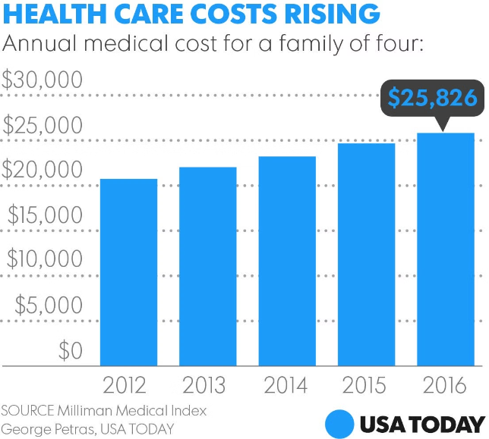
Introduction to the Problem
1
Importance of Accurate Pricing
Precise medical insurance pricing is crucial for both consumers and providers to ensure affordable and sustainable healthcare coverage.
2
Challenges in Pricing
Factors like individual health profiles, regional variations, and changing regulations make medical insurance pricing a complex task.
3
Objective
To develop a predictive model that can forecast medical insurance prices based on relevant data points.

Slide 6


Data Collection and Preprocessing
Data Sources
Gather data from various sources, including insurance providers, government databases, and healthcare organizations.
Data Cleaning
Clean and preprocess the data, addressing missing values, outliers, and inconsistencies to ensure data quality.
Feature Selection
Identify the most relevant features that influence medical insurance pricing, such as age, location, and health conditions.

Slide 7
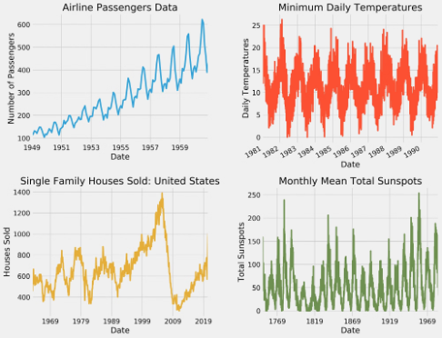
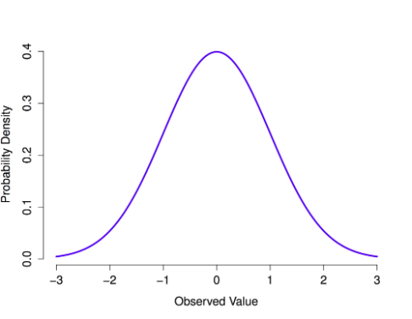
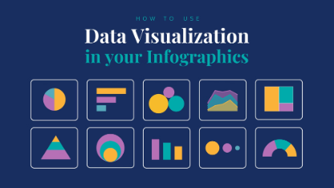
Exploratory Data Analysis
Identify Patterns
Understand Distributions
Visualize Insights
Analyze the data to uncover trends, correlations, and relationships between different variables.
Examine the distribution of insurance prices and other key features to gain insights into the data.
Create visualizations, such as charts and graphs, to effectively communicate the findings from the data analysis.

Slide 8
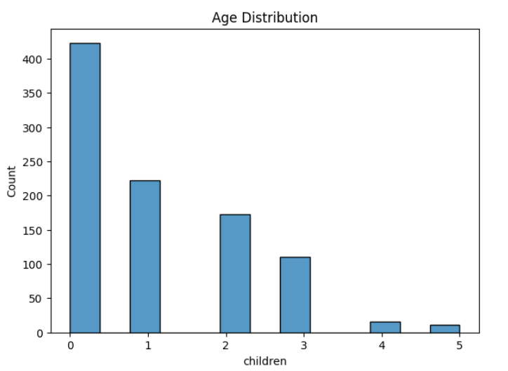
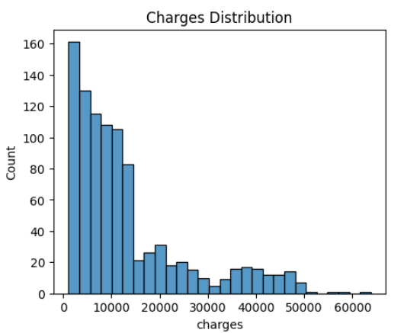
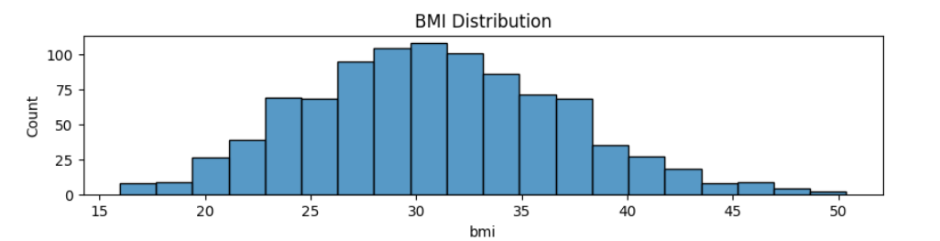
DATA VISUALIZATION - HISTROGRAM

Slide 9
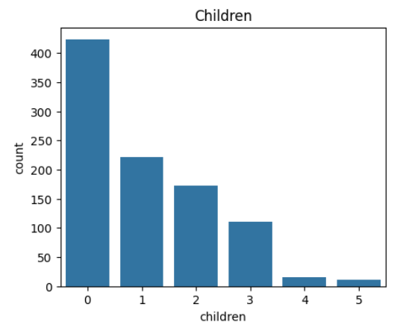
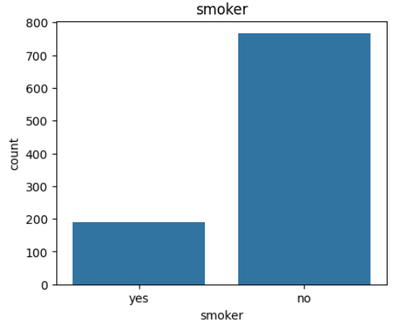
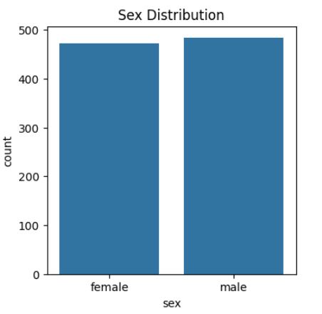
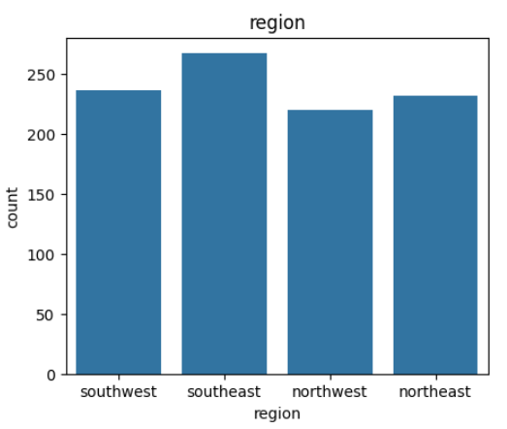
DATA VISUALIZATION - COUNTPLOT

Slide 10


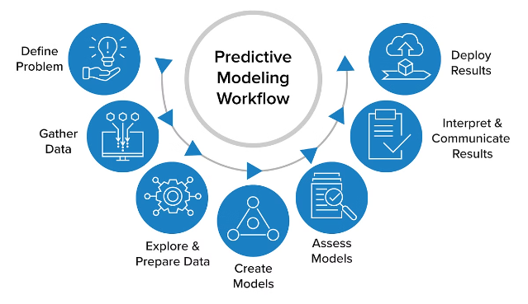


Feature Engineering
Feature Selection
Carefully select the most relevant features that can significantly impact the insurance pricing model.
Feature Transformation
Apply appropriate transformations to the features, such as scaling, encoding, or creating new derived features.
Feature Importance
Evaluate the relative importance of each feature to understand their contribution to the model's predictive power.

Slide 11

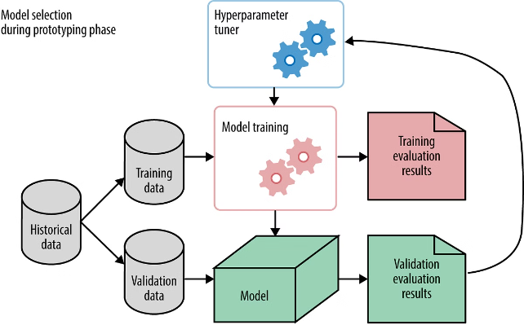
Model Selection and Tuning
1
Model Evaluation
Test various machine learning algorithms, such as regression models, decision trees, and ensemble methods, to identify the best-performing model.
2
Hyperparameter Tuning
Optimize the model's hyperparameters to improve its performance and generalization capabilities.
3
Cross-Validation
Employ cross-validation techniques to ensure the model's robustness and prevent overfitting.

Slide 12

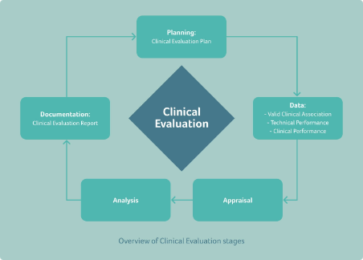



Model Evaluation and Validation
Evaluation Metrics
Validation
Sensitivity Analysis
Assess the model's performance using relevant metrics, such as mean squared error, R-squared, and root mean squared error.
Validate the model's performance on unseen data to ensure its generalizability and real-world applicability.
Analyze the model's sensitivity to changes in input variables to understand its robustness and limitations.

Slide 13
Deployment and Integration
Cloud Integration
API Integration
User Interface
Deploy the model on a cloud platform to ensure scalability and accessibility.
Develop an API to seamlessly integrate the model into existing systems and applications.
Create a user-friendly interface to enable intuitive interaction with the model.
Implement monitoring and maintenance processes to ensure the model's ongoing performance and reliability.

Slide 14
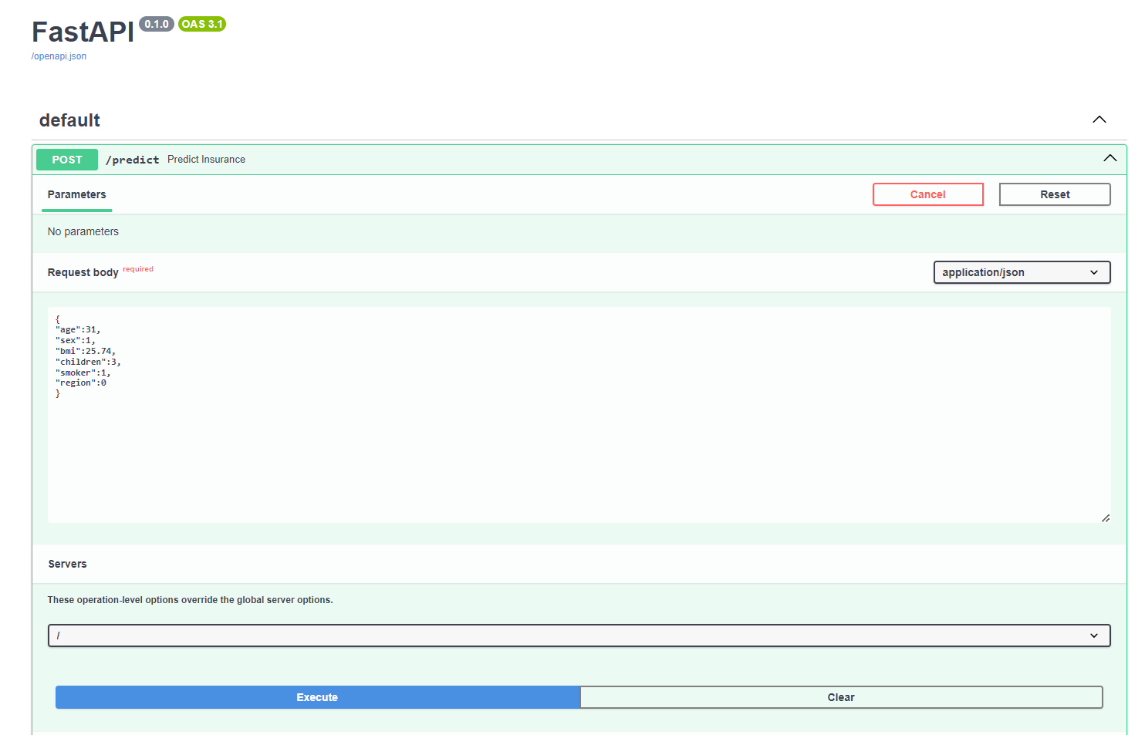
Deployment and Integration – FASTAPI (Request Body)

Slide 15
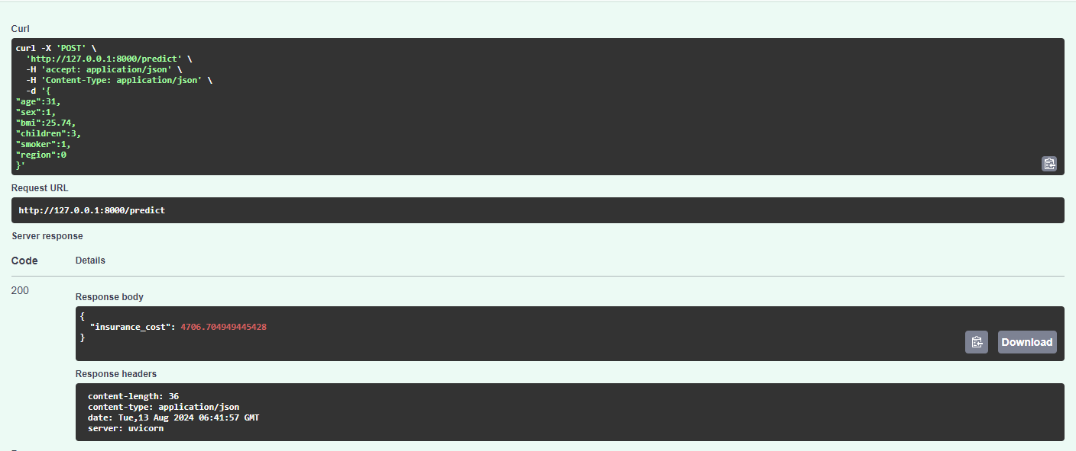
Deployment and Integration – FASTAPI (Predictions)

Slide 16


Challenges and Limitations
1
Data Availability
2
Privacy Concerns
Obtaining comprehensive and reliable data on medical insurance pricing can be a significant challenge.
Ensuring the protection of sensitive personal health information is crucial when working with medical data.
3
Model Complexity
4
Regulatory Considerations
Developing a highly accurate and interpretable model for medical insurance price prediction can be a complex task.
Understanding and adhering to evolving regulations in the healthcare industry is essential for the model's deployment.

Slide 17


Future Enhancements
Incorporate Real-time Data
Integrate the model with real-time data sources to enable dynamic pricing updates.
Personalized Recommendations
Develop personalized insurance recommendations based on individual health profiles and preferences.
Predictive Analytics
Expand the model's capabilities to predict future healthcare trends and potential cost changes.
Explainable AI
Enhance the model's interpretability to provide transparent and understandable insights to users.

Slide 18

This Photo by Unknown Author is licensed under CC BY-SA

